Slide 1


Medium-fi Prototyping
Natasha Goh, Ben Gregory, Michelle Huang, Cooper Reed

Slide 2
Problem
Value Proposition
Solution
Millennials and Gen Z have a desire to support socially conscious brands but have difficulty finding these brands locally.
Our smartphone app enables users to search for shops based on ethical criteria, exchange recommendations to friends, and develop relationships with local businesses.
Local Made
Easy

Slide 3
Task #1- Simple
Buy value-driven product(s) locally
Notes:
He makes notes of recommendations from colleagues / friends and girlfriend keeps detailed maps of pinned locations

Slide 4
Task #2 - Medium
Build relationships with local businesses
Notes:
He makes notes of recommendations from colleagues / friends and girlfriend keeps detailed maps of pinned locations

Slide 5
Task #3 - Complex
Discover new businesses with similar values
Notes:
He makes notes of recommendations from colleagues / friends and girlfriend keeps detailed maps of pinned locations

Slide 6
Task #3.5 - Complex
Share businesses with friends
Notes:
He makes notes of recommendations from colleagues / friends and girlfriend keeps detailed maps of pinned locations

Slide 7
Major Design Changes
Update rewards bar to more explicitly indicate purchase history
Make card status (Silver, Gold, etc.) and associated benefits clearer
Move “Ask for Recommendations” from Profile to Friends section

Slide 8
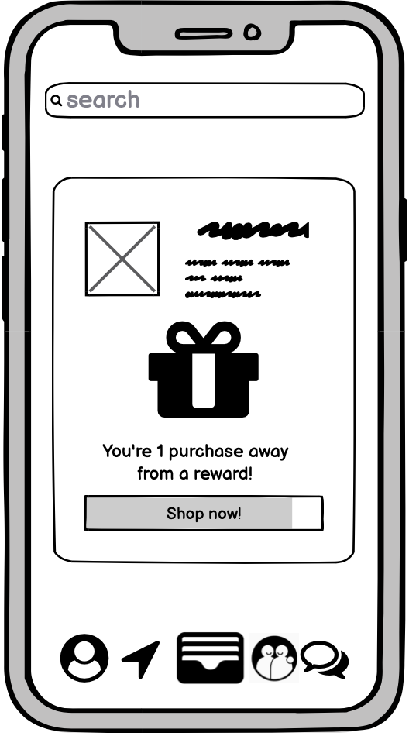
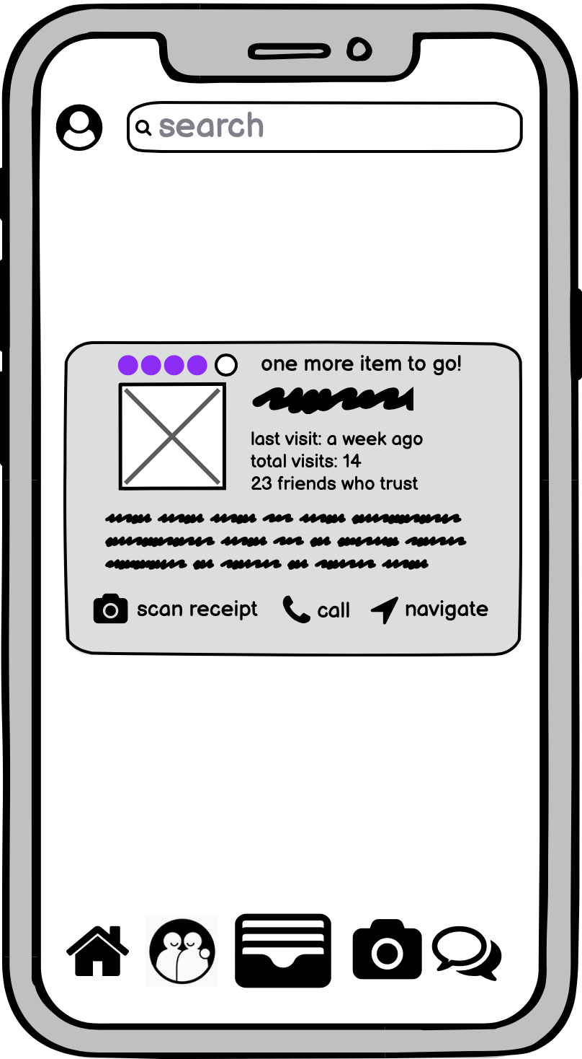
Design Change #1 - Update Rewards Bar

Slide 9
Design Change #1 - Update Rewards Bar - Rationale
Before:
The rewards bar previously was overlaid on the “Shop Now” button and perhaps because of the grayscale nature of the low-fi prototype, users did not typically notice this as a progression. Because there was not a clear history linked to the shopping experience, the card was viewed neutrally or negatively, with one user believing it was an ad.
After:
The rewards bar was moved off the “Shop Now” button to give it more importance and weight by representing it on its own. It also explicitly calls out the current status of the card and measurable progression to the next level to demonstrate to the user a history of shopping with the store. While we initially planned on implementing this via a “punch card” interface, we decided to retain the progress bar to allow for more flexibility in how cards can be upgraded.

Slide 10
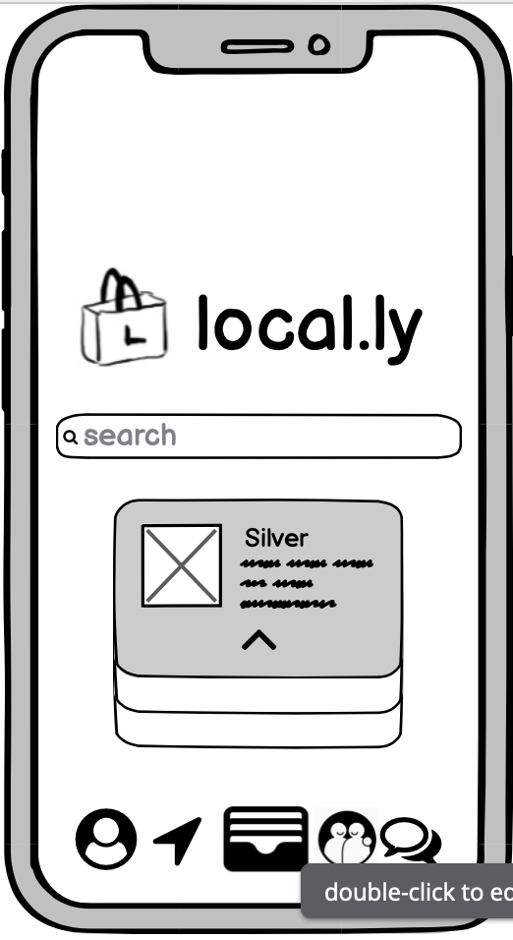
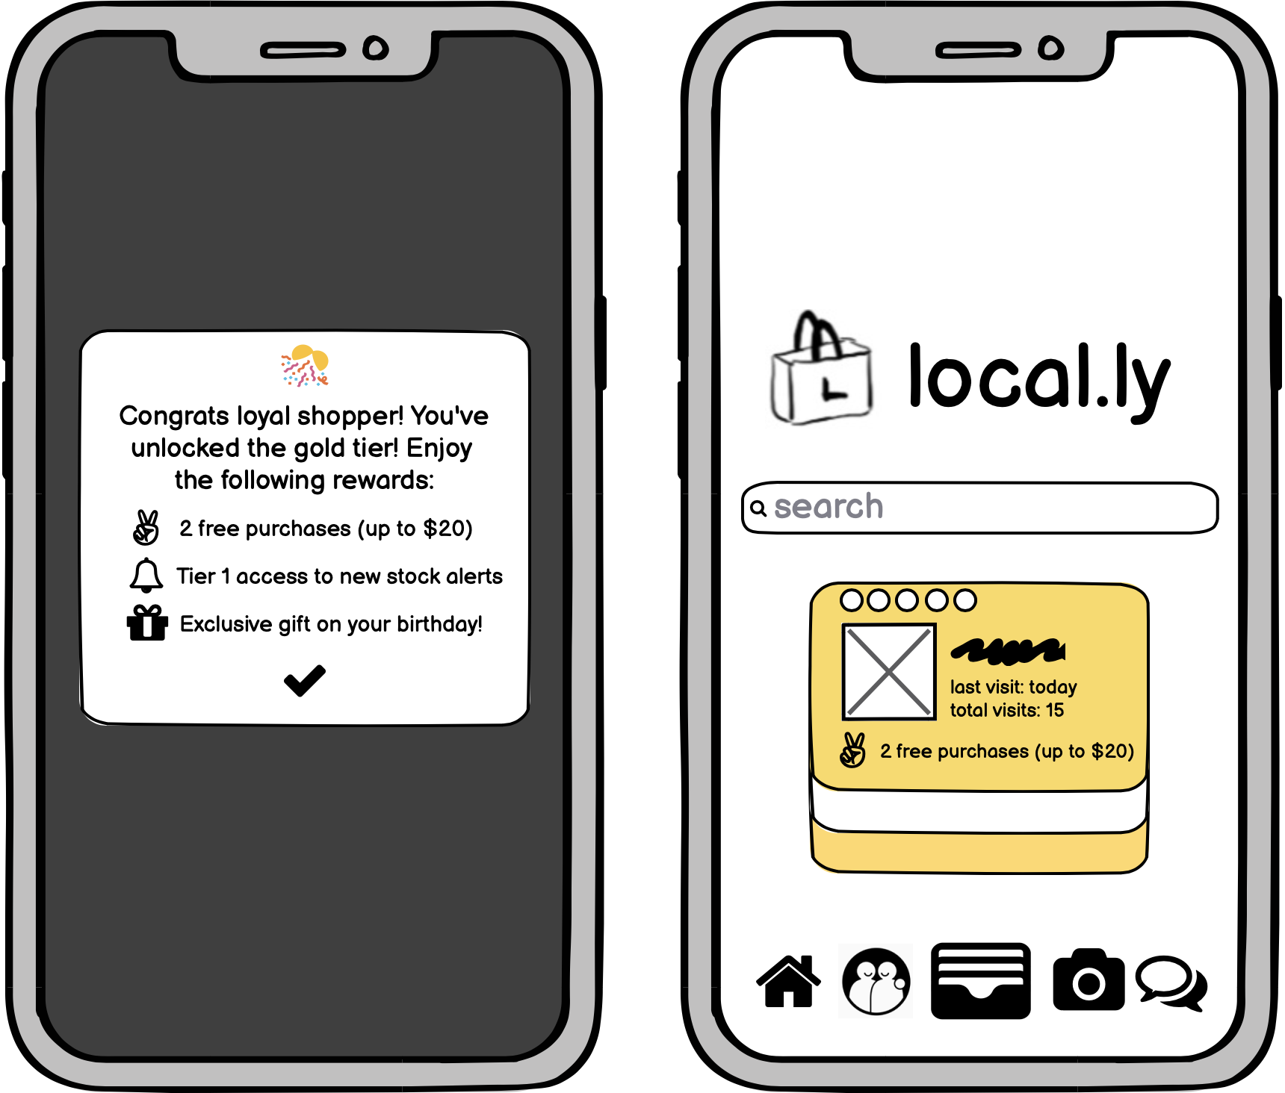
Design Change #2 - Make Card Status Clearer

Slide 11
Design Change #2 - Make Card Status Clearer - Rationale
Before:
As part of our task of developing a relationship with businesses, cards would be visually changed to reflect the current status of the relationship (e.g. Bronze, Silver, Gold, etc.). However, the status was not always apparent to the user and when it was, it was not always clearly associated with any kind of behavior or reward structure. Further, not all users recognized when the cards changed or what action led it to change.
After:
To make it more clear what the card status represented and what rewards you received as part of this upgrade, an additional pop up screen was added to relay this information. This pop up explicitly references loyalty and the updated rewards structure to make it clear that a benefit has been received and it is a result of the users continued relationship with the business. To connect it further to the result of previous shopping, it is designed to pop up right after a new purchase has been added to the user’s account.

Slide 12
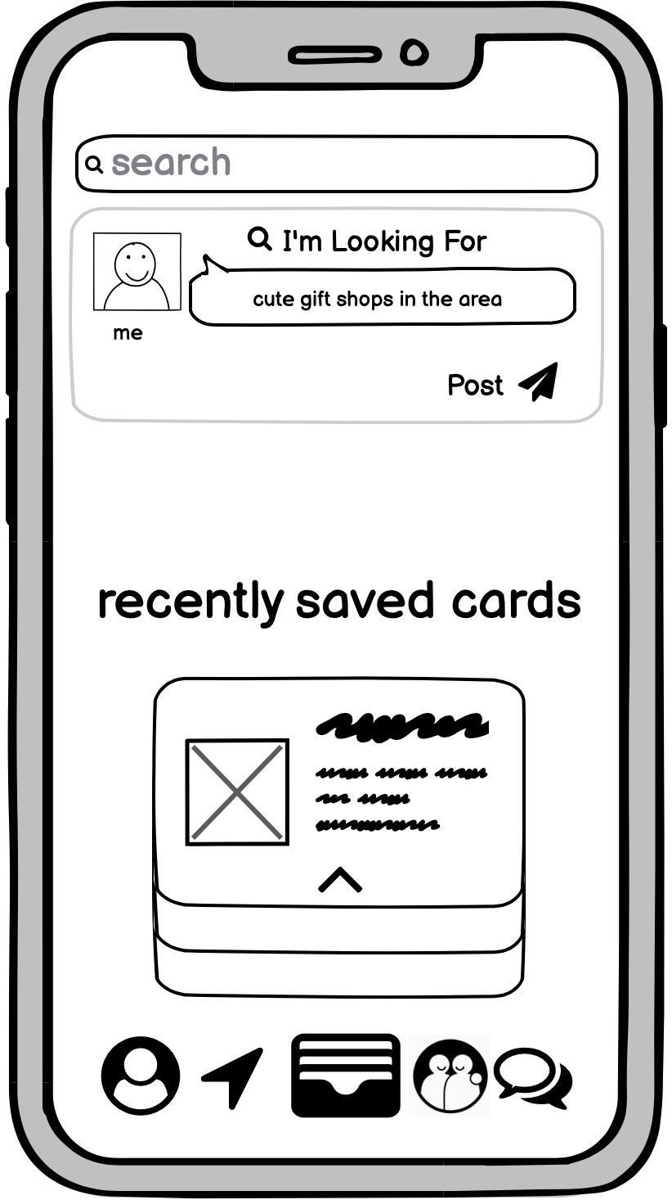
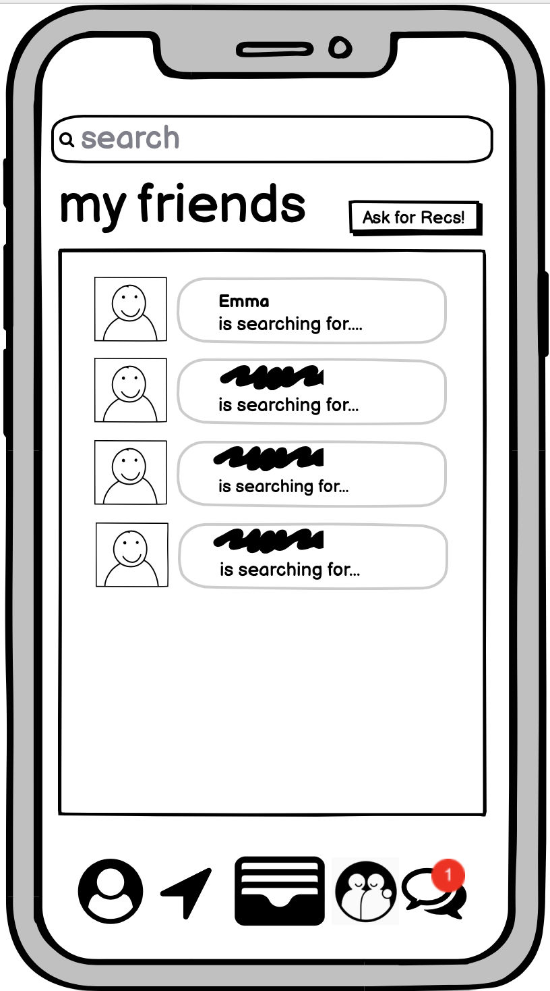
Design Change #3 - Move Ask from Profile to Friends

Slide 13
Design Change #3 - Move Ask from Profile to Friends - Rationale
Before:
A large part of our app mechanics involve the discovery of new businesses through making requests with your network. We initially had this mechanic in the profile section (as the request is a part of the user’s experience) but it was not intuitive that users should go to their profile to make a request of their friends.
After:
We moved the “Ask for recommendations” mechanic to the Friends section where all of their network’s requests were being tracked. This creates a more unified experience as now all requests for recommendations are kept in the same section of the app rather than those of your friends in the friends section and personal requests in your profile.

Slide 14
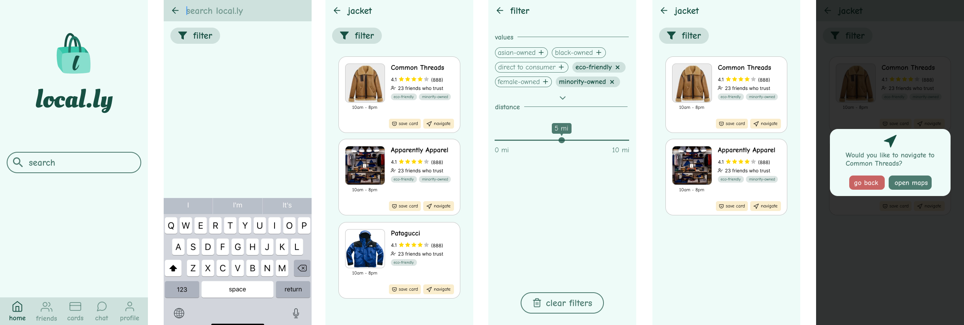
Task Flow #1:
Buy value-driven product(s) locally

Slide 15
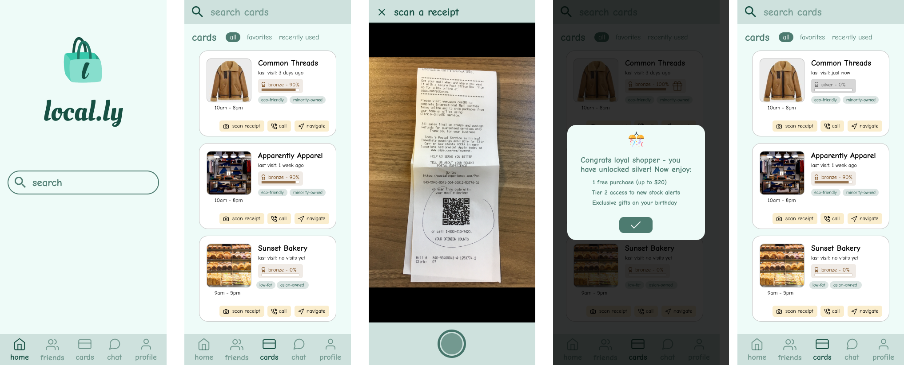
Task Flow #2:
Build relationships with local businesses

Slide 16
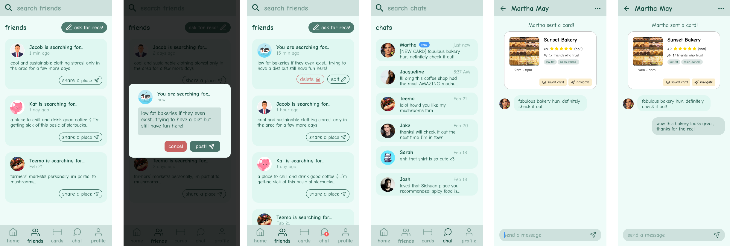
Task Flow #3:
Discover new businesses with similar values

Slide 17
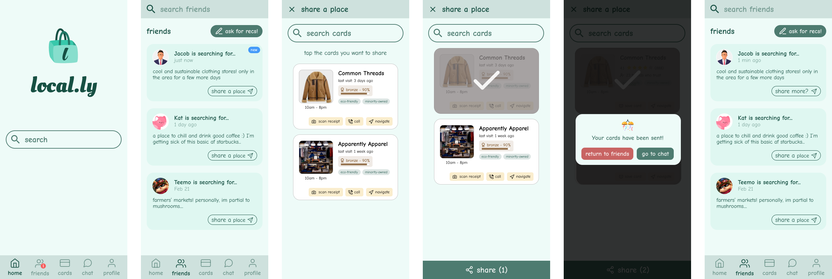
Task Flow #3.5:
Share business with friends

Slide 18
Prototype Overview

Slide 19
Good
Bad
Smooth collaboration (no concurrency issues like Balsamiq)
Figma Plugins are helpful
Ease of “Pages” hierarchy to keep separate work from different stages
Wireframing for remote testing
Complicated interface for medium-fi
Difficulting masking
Cannot move shapes within components
No preview in font selection
Unable to search frames was really unwieldy once we reached 20+ frames and had to manually scroll to find a frame
Figma

Slide 20
Limitations and Tradeoffs
Limitation: Few available clickable regions to maintain continuity in our task flows.
Limitation: Opening Maps (which should open Google Maps or whatever default map app the user has set) was left out as this would require API support from Figma.
Limitation: The "call" button on store cards (which should open up the user's phone app with the store's associated number) was left out as this would require calling support.
Limitation: Could not simulate swipes using Figma so designed with clickable buttons.
Tradeoff: To focus on our 4 main task flows, we have left out some features and screens, like a sign out button, and the screens that would correspond to the options on the profile (edit profile, add friends, account settings).
Tradeoff: We simulated the passage of time through different screens with notification bubbles and different timestamps since we did not want users of our medium-fi prototype to spend a long amount of time waiting until they could progress on certain tasks.

Slide 21
Wizard of Oz techniques
Pre-filled chats to simulate time-progression
Simulated the passage of time between when a user asks for a recommendation and receives one through a different screen that shows their post is now 15 minutes old
Notification pop-up to signal message from friend
“Filter” your search results
Users can currently only search for jackets, and we've limited the value filters that users can apply
Mocked up fake receipt

Slide 22
Hardcoded Features
Login / Logout
Auth process required
Stores
Store results & all store details that appear on cards (i.e. rating, number of friends who trust, store hours)
Card rank progress and receipt-scanning is hard-coded to facilitate demonstrating the functionality
Profile Data and Friends
Chat with friends
When the user clicks text boxes or the keyboard in certain instances, we auto-fill the text box with a hard-coded message since we can't process user input.
The store recommendation the user can ask for, and the recommendation card the user receives is hard-coded.
We also simulated the user receiving a notification showing their friend has asked for a recommendation by having a separate home screen that the user encounters later in the flow.

Slide 23
Figma Link: https://www.figma.com/proto/ptoDW2Drn3HL8zzb8Kz8aG/Local.ly-Medium-fi-Prototype?node-id=133%3A129663&scaling=scale-down

Slide 24
Appendix

Slide 25
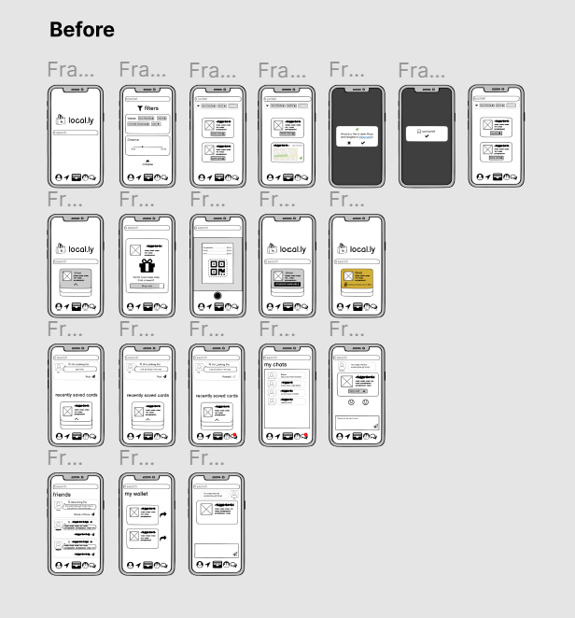
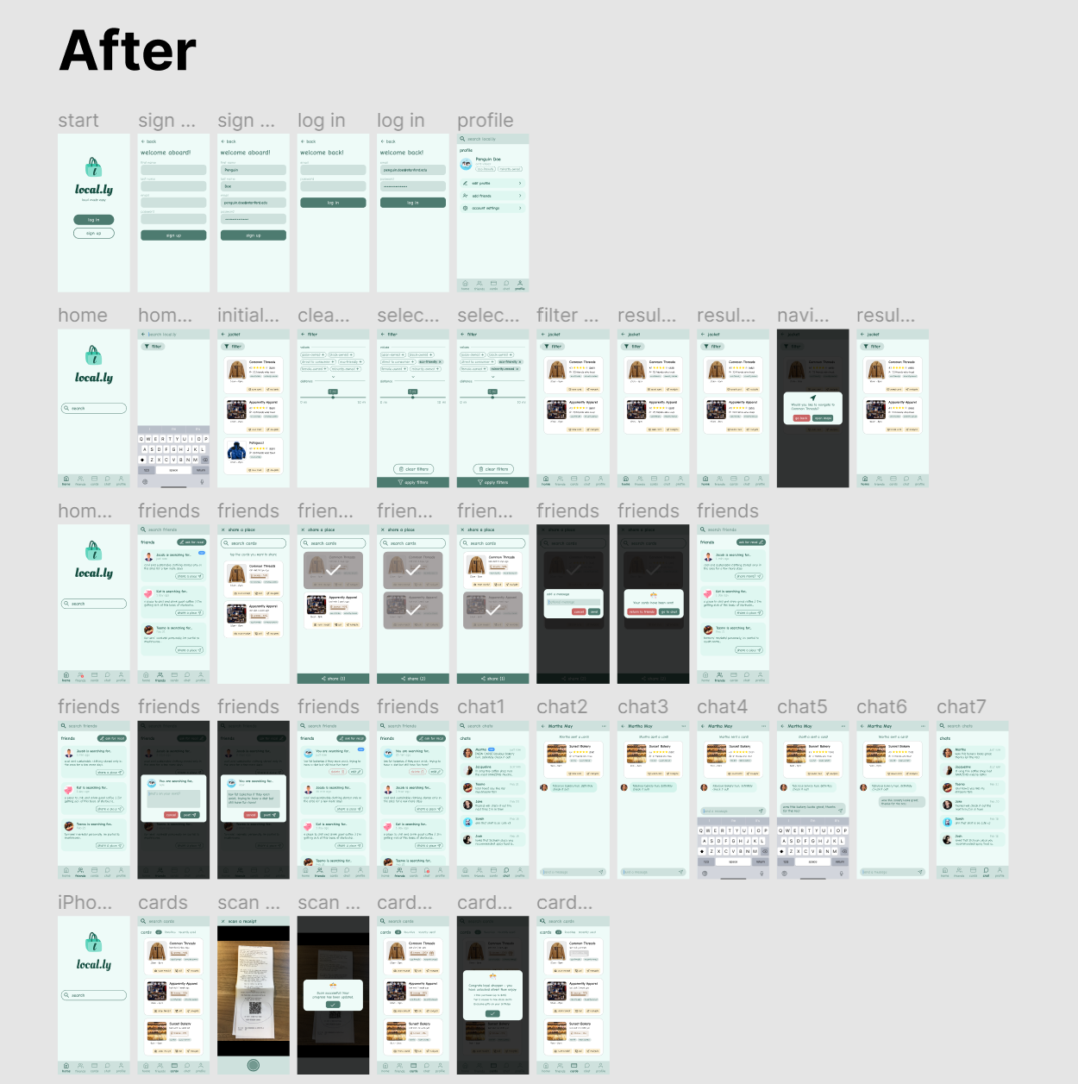
All Screens
Low-Fi
Medium-Fi

Slide 26
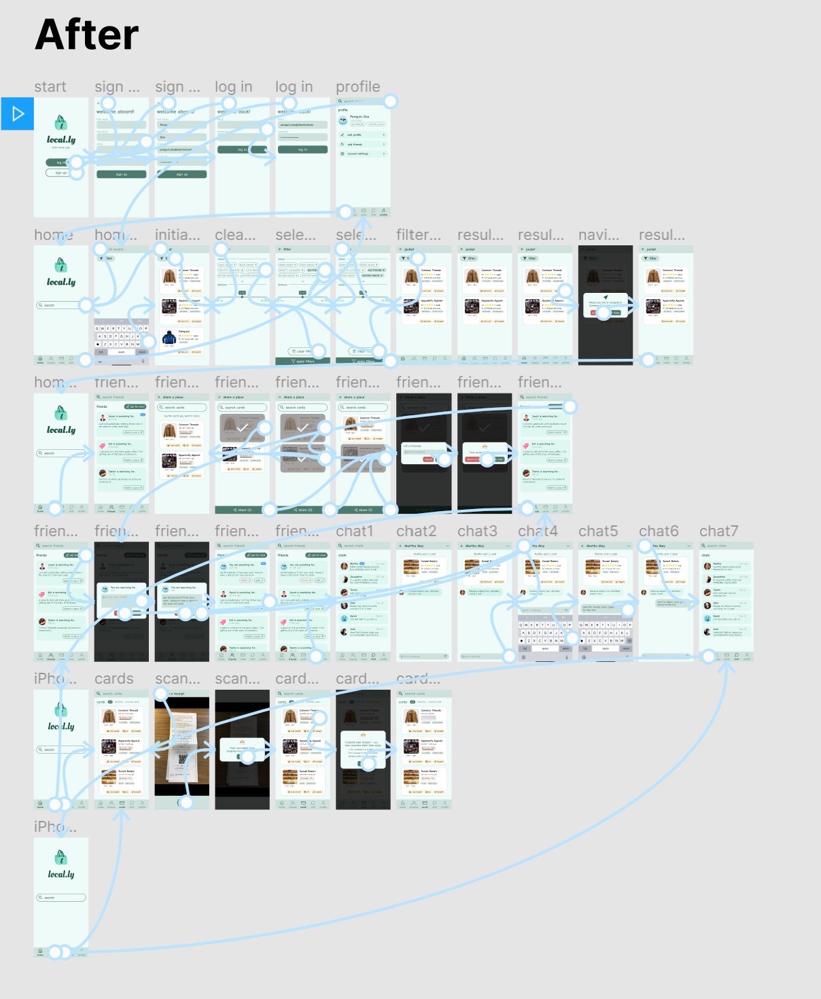
Medium-Fi Wired

Slide 27
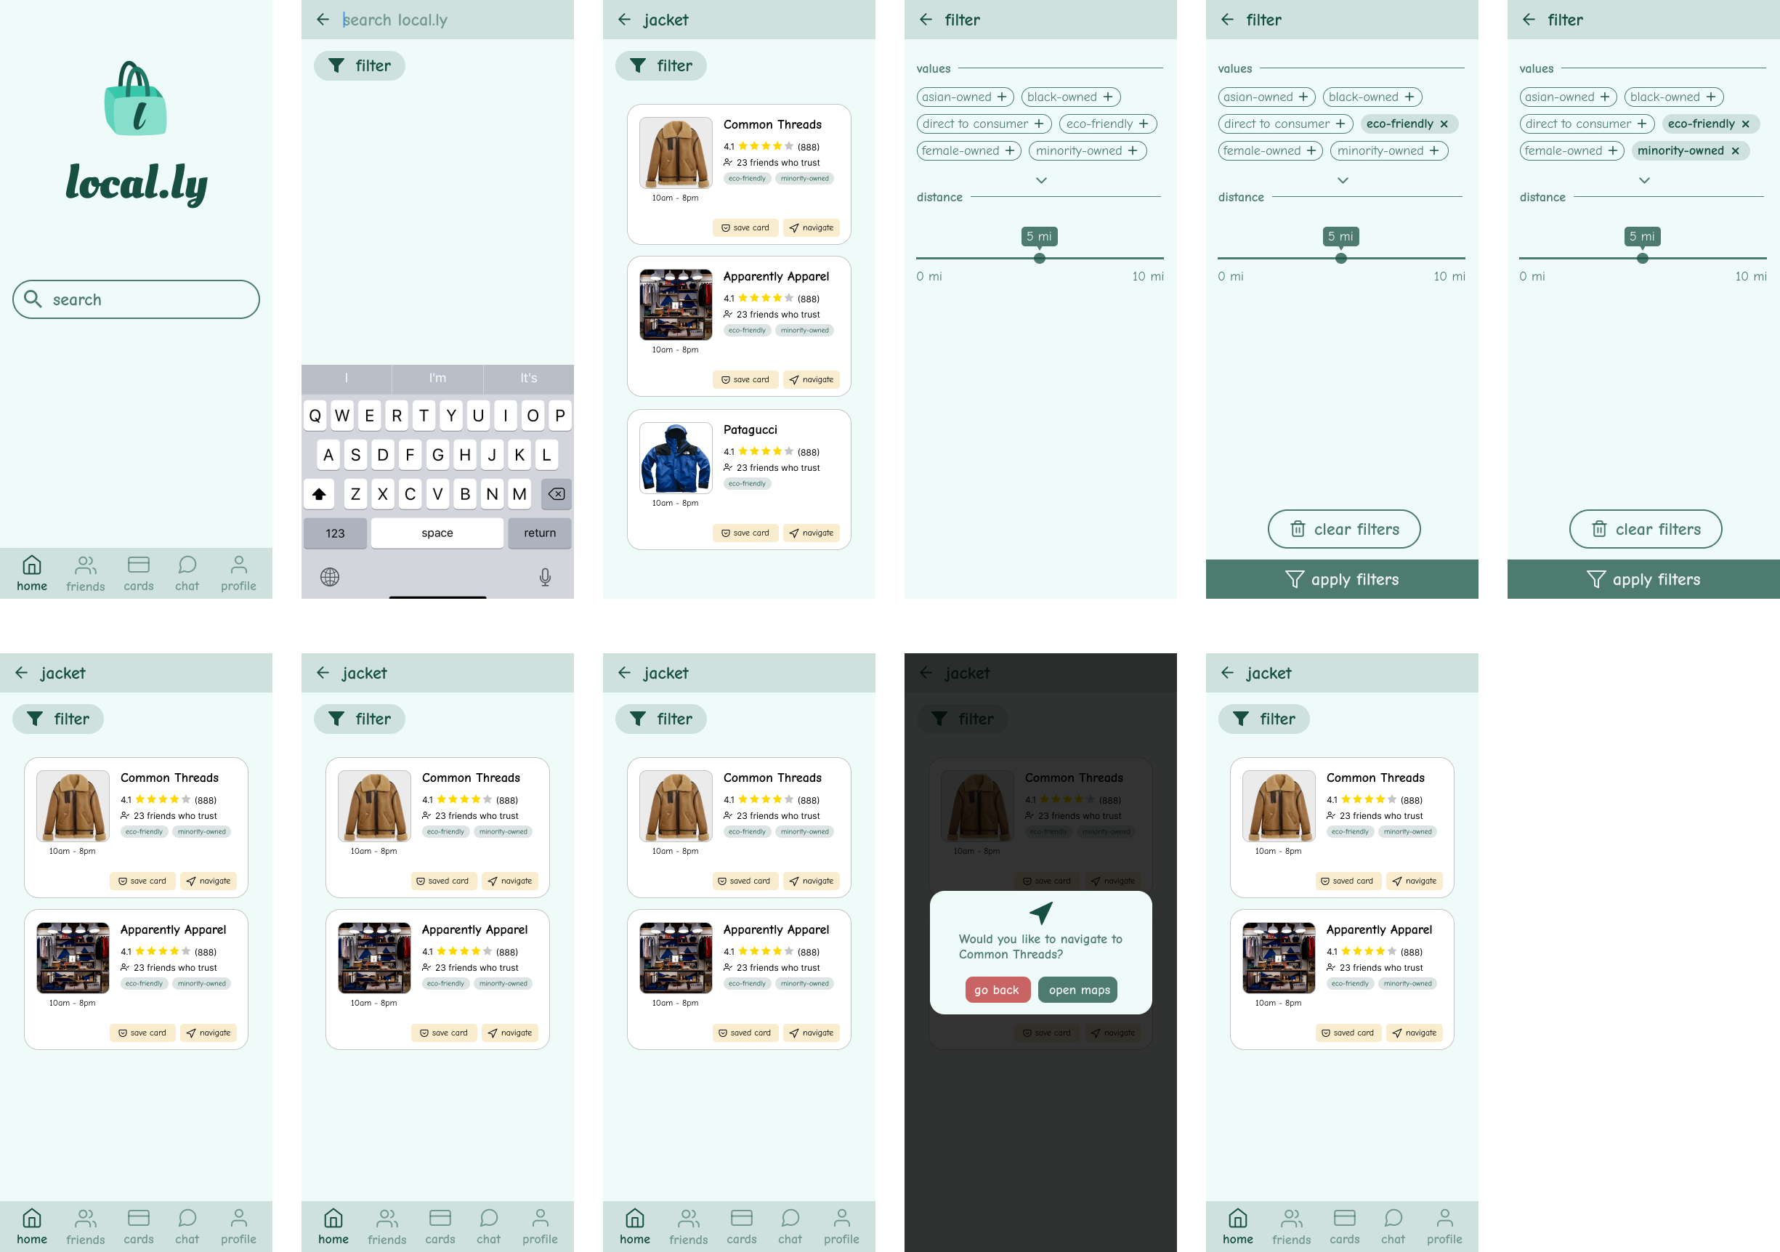
Task Flow #1 - Full:
Buy value-driven product(s) locally

Slide 28
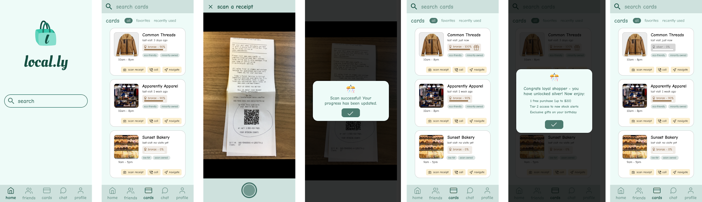
Task Flow #2 - Full:
Build relationships with local businesses

Slide 29
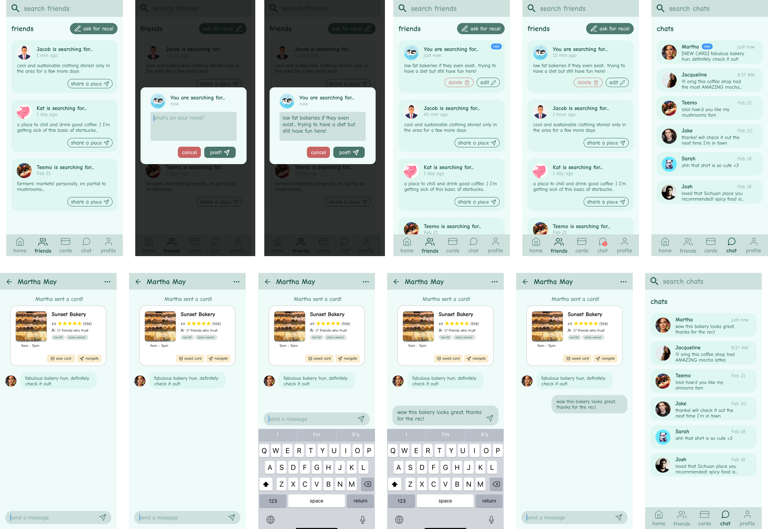
Task Flow #3 - Full:
Discover new businesses with similar values

Slide 30
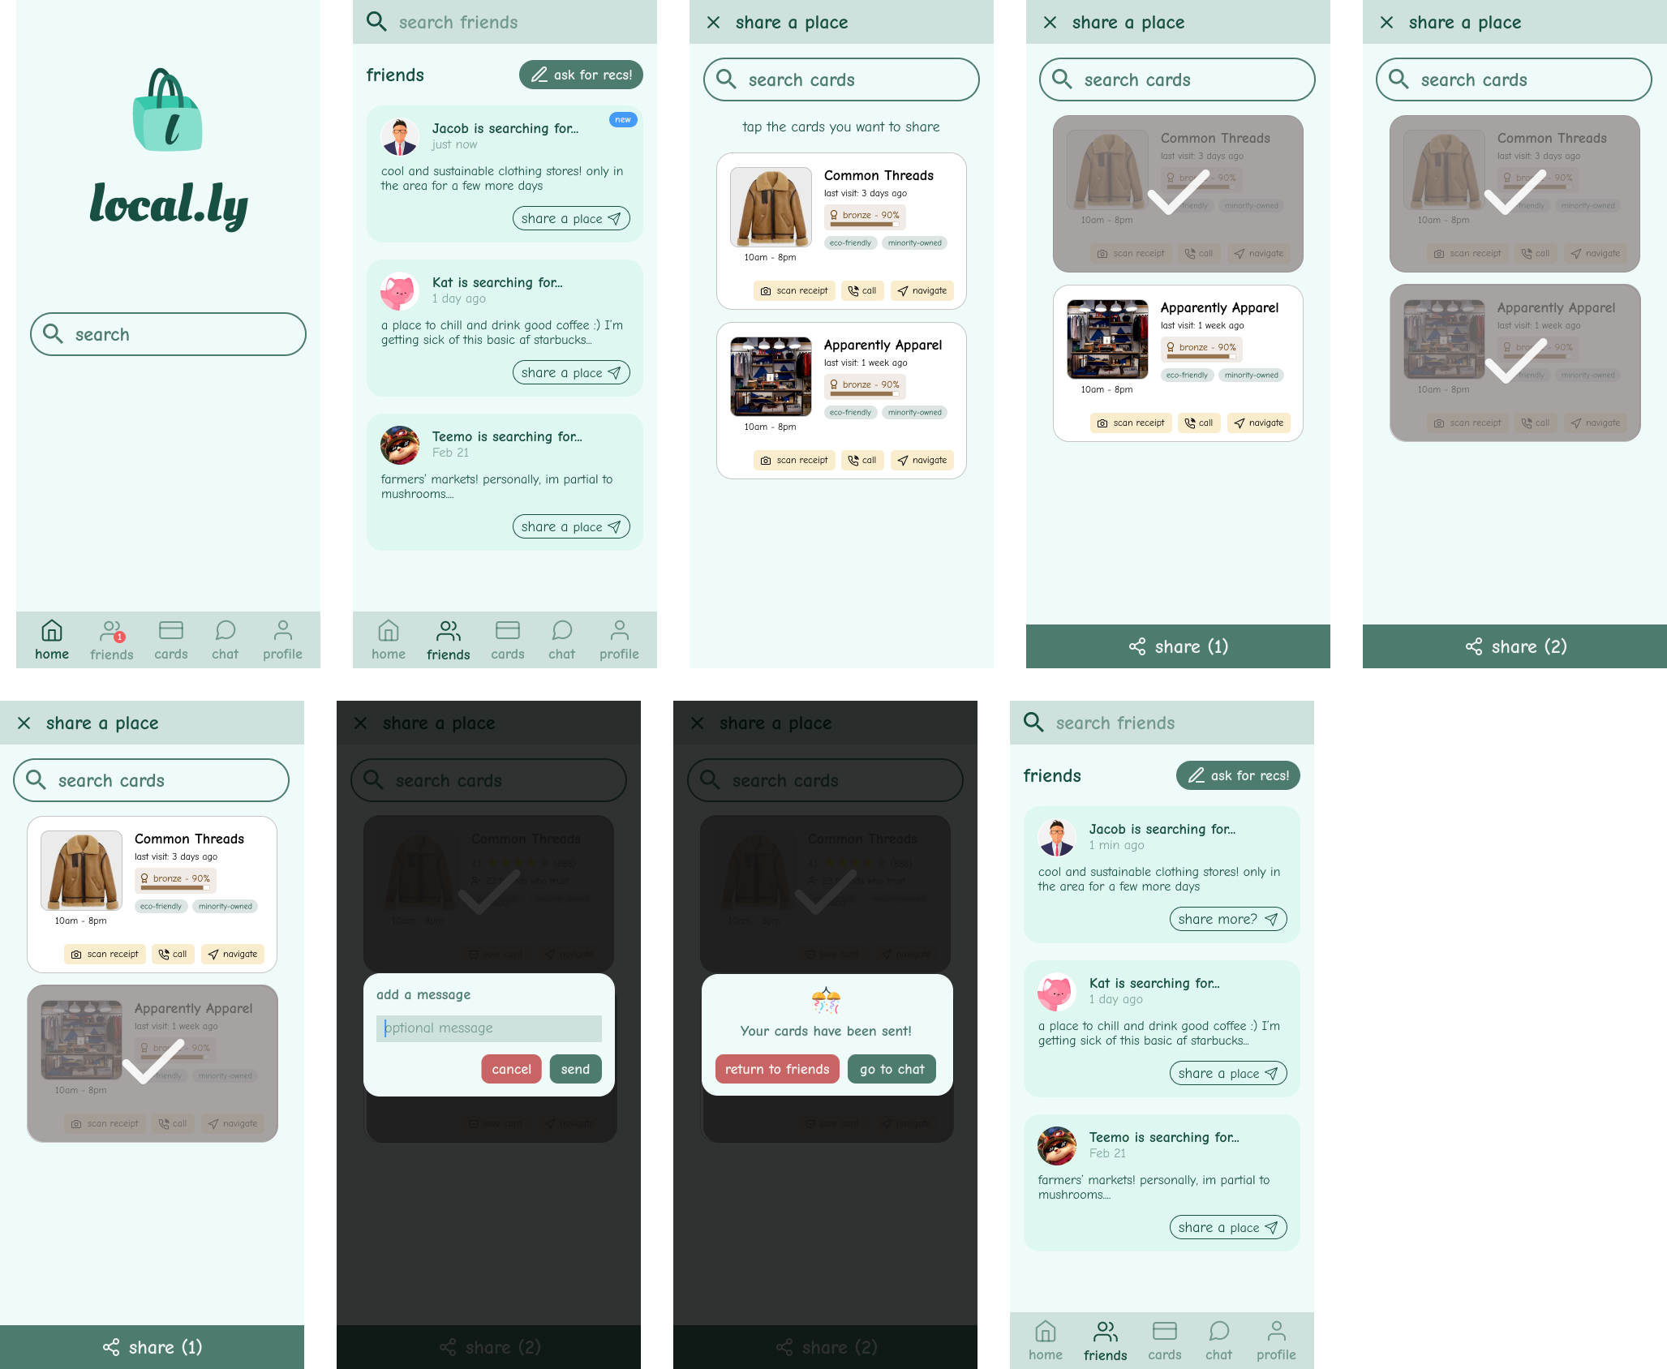
Task Flow #3.5 - Full:
Share a businesses with friends

Slide 31
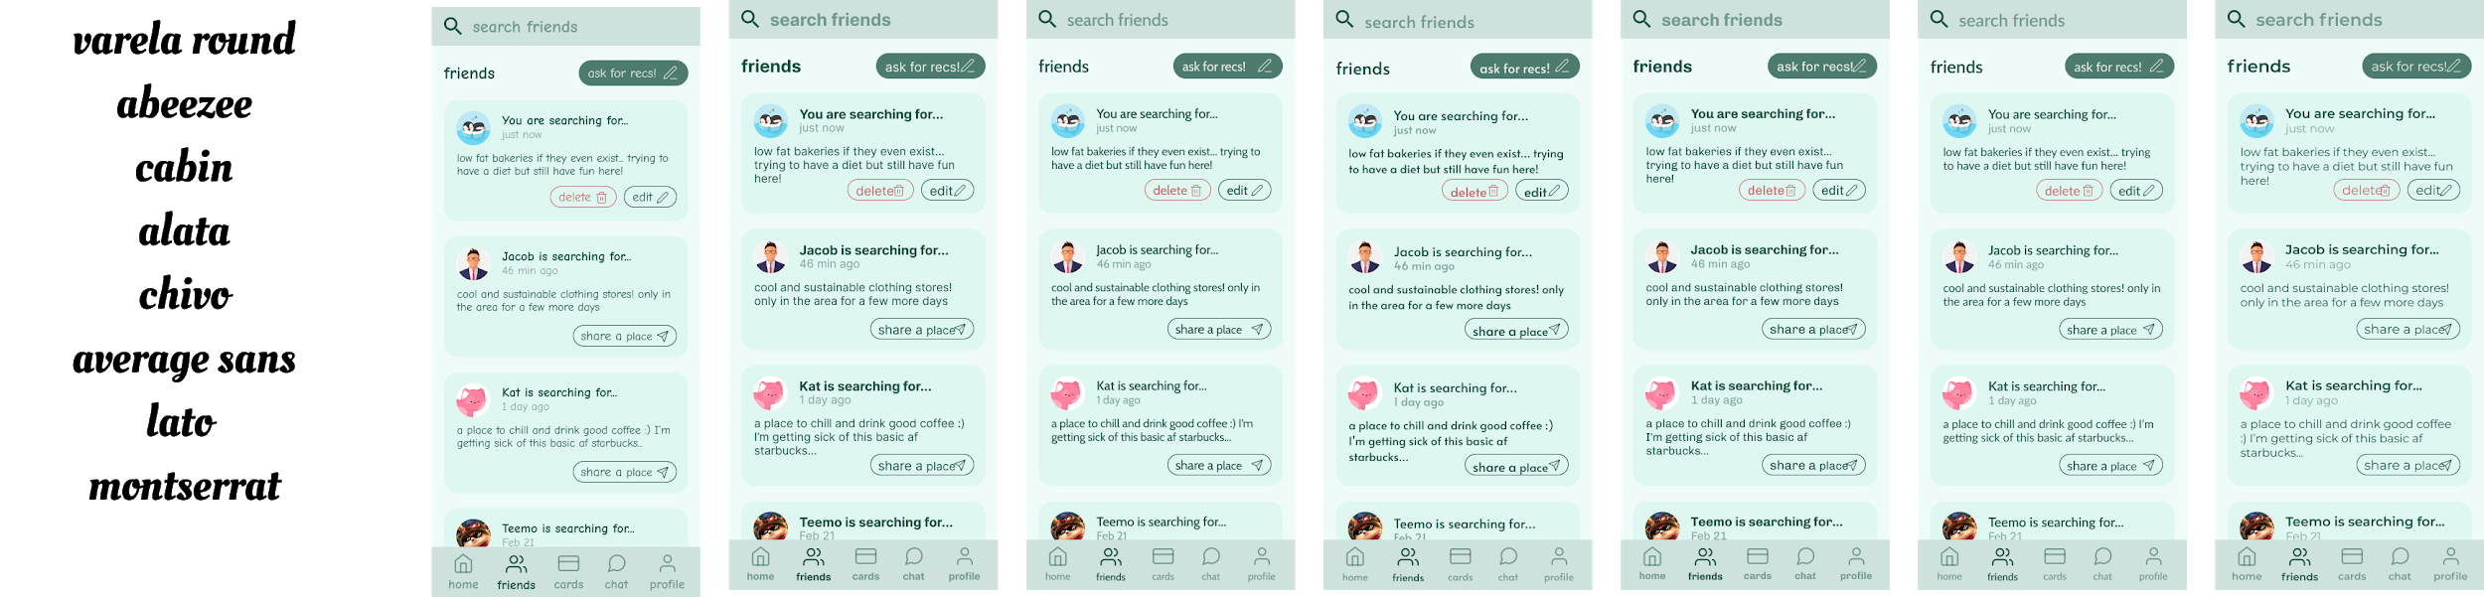
Font Experimentation
(we decided we would switch to Lato for the high-fidelity prototype)

